Slide 1
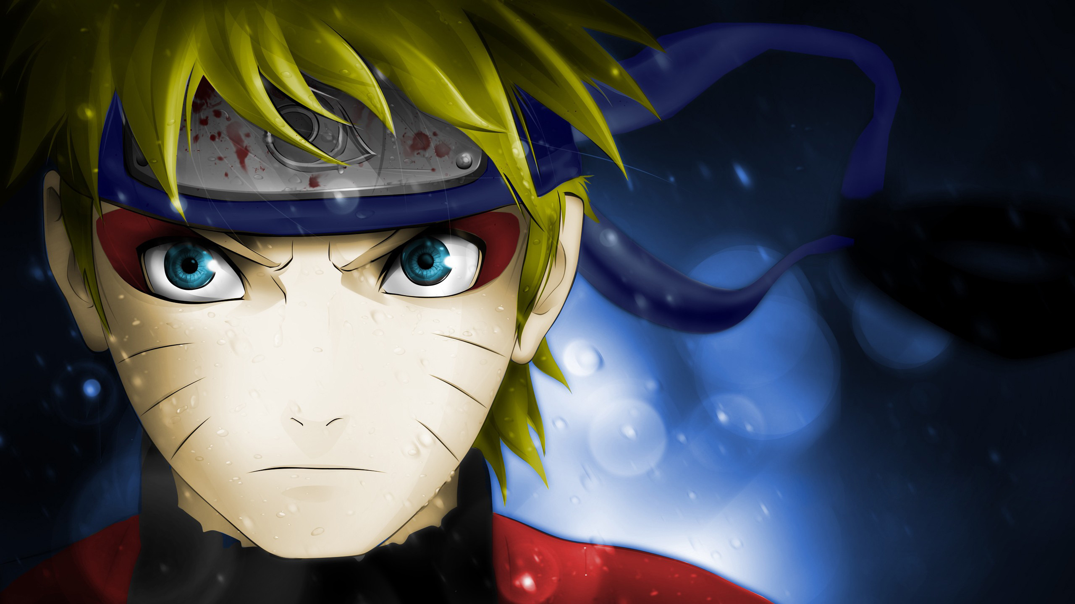
Naruto
Notes:
Tokey

Slide 2
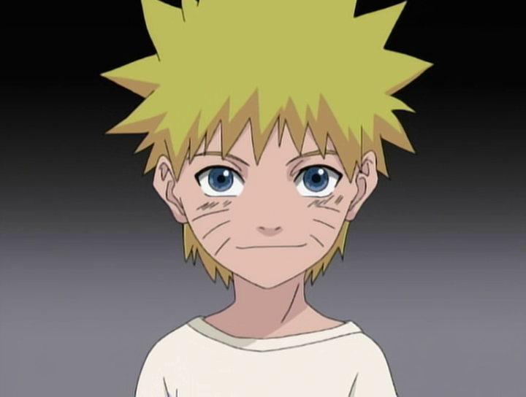
Supervised By-
Mohammad Moinul Hoque
Md. Tawseef Alam
Submitted By :
14.02.04.066 – Samin Shahriar Tokey
14.02.04.070 – Biozid Rahman Niloy
14.02.04.080 – Naimul Haque
Notes:
Niloy

Slide 3
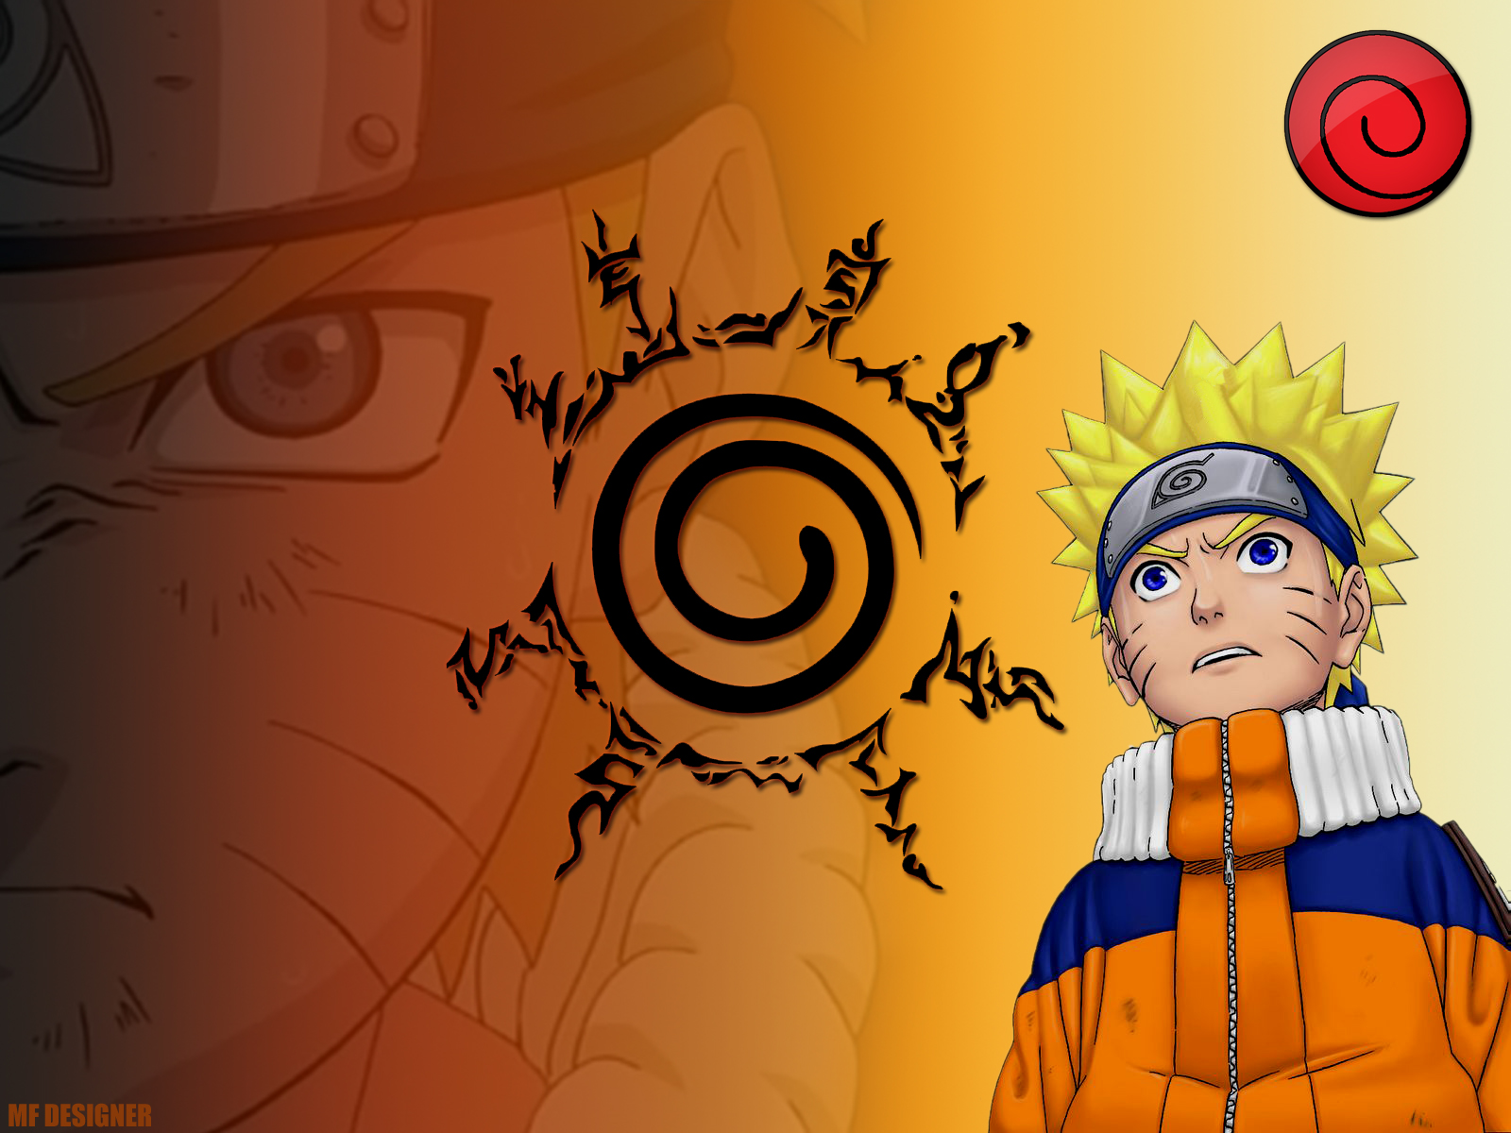
Who is Naruto?
Naruto is a Japanese manga series written and illustrated by Masashi Kishimoto. It tells the story of Naruto Uzumaki, an adolescent ninja who constantly searches for recognition and dreams to become the Hokage.
He has the nine tailed fox’s spirit sealed inside his body. As the nine tailed fox is one of the tailed beasts and as Naruto is the one who has the spirit sealed inside him , he is known as the “Jinjuriki”.
He has incredible amount of stamina and can heal on his own.
Notes:
Niloy

Slide 4
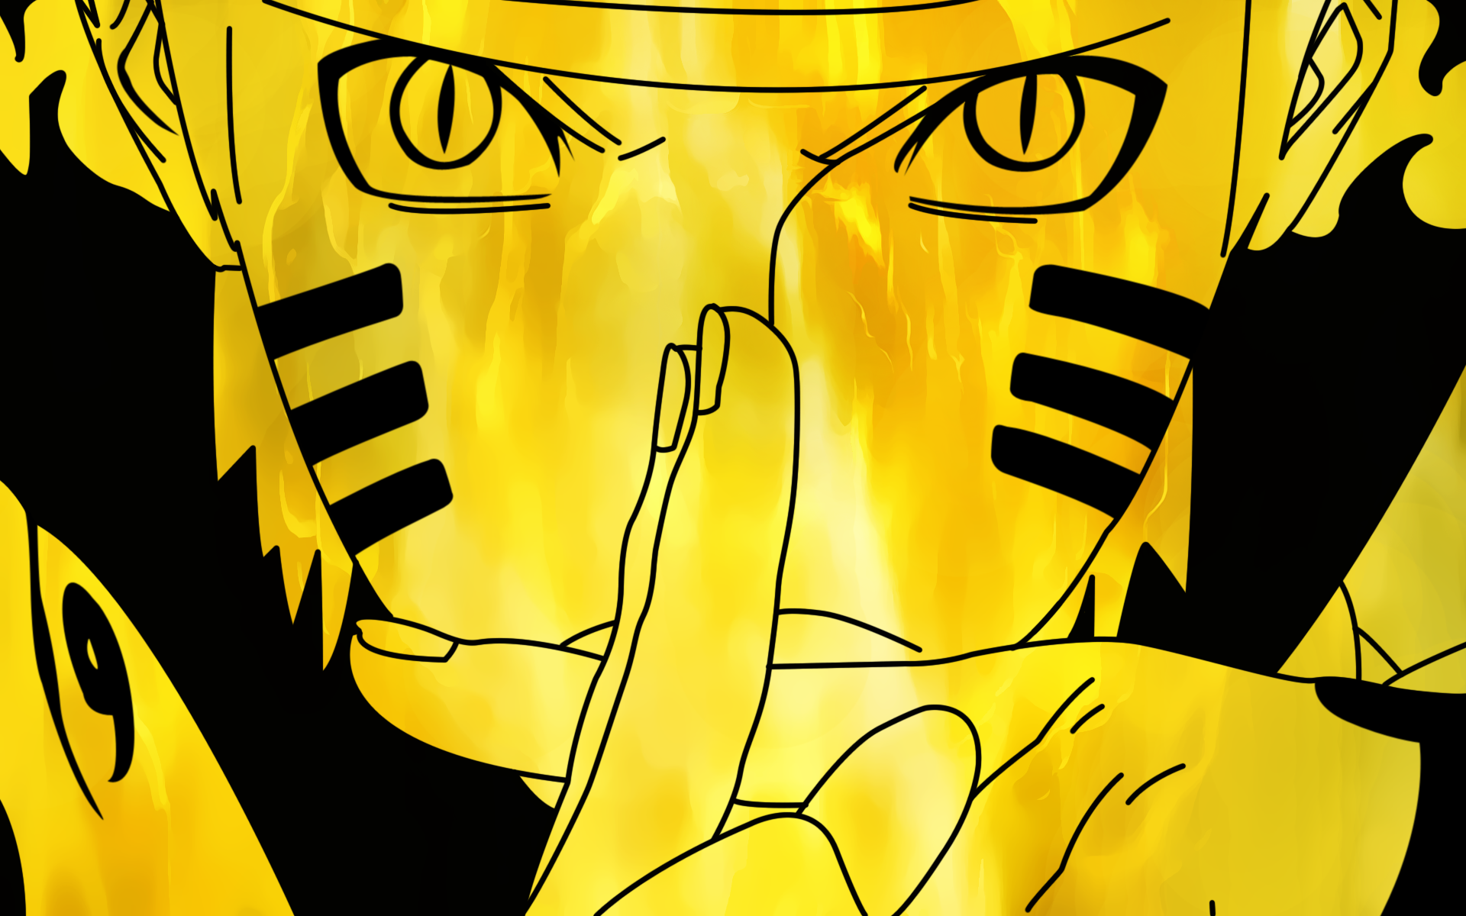
What are we trying to implement?
We are trying to manipulate some features of Naruto and our goal is to make a Naruto arcade game.
Notes:
Niloy

Slide 5
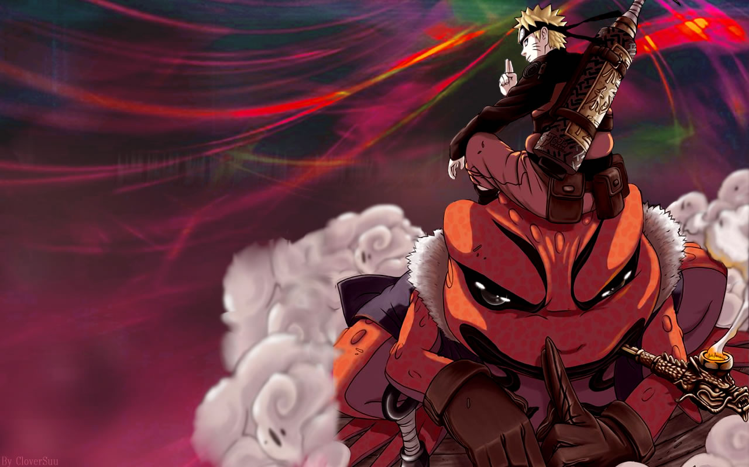
Aims And Needs
Aims
Our aim is to make the best use of java GUI and make a 2D arcade game based on Naruto.
Needs
At present there are billions of developers who are developing various types of games for entertainment. We want to be a part of that.
There are not enough quality Naruto games made with java nor android. We want to make a that wont just look good , but also will be fun to play.
Notes:
Niloy

Slide 6
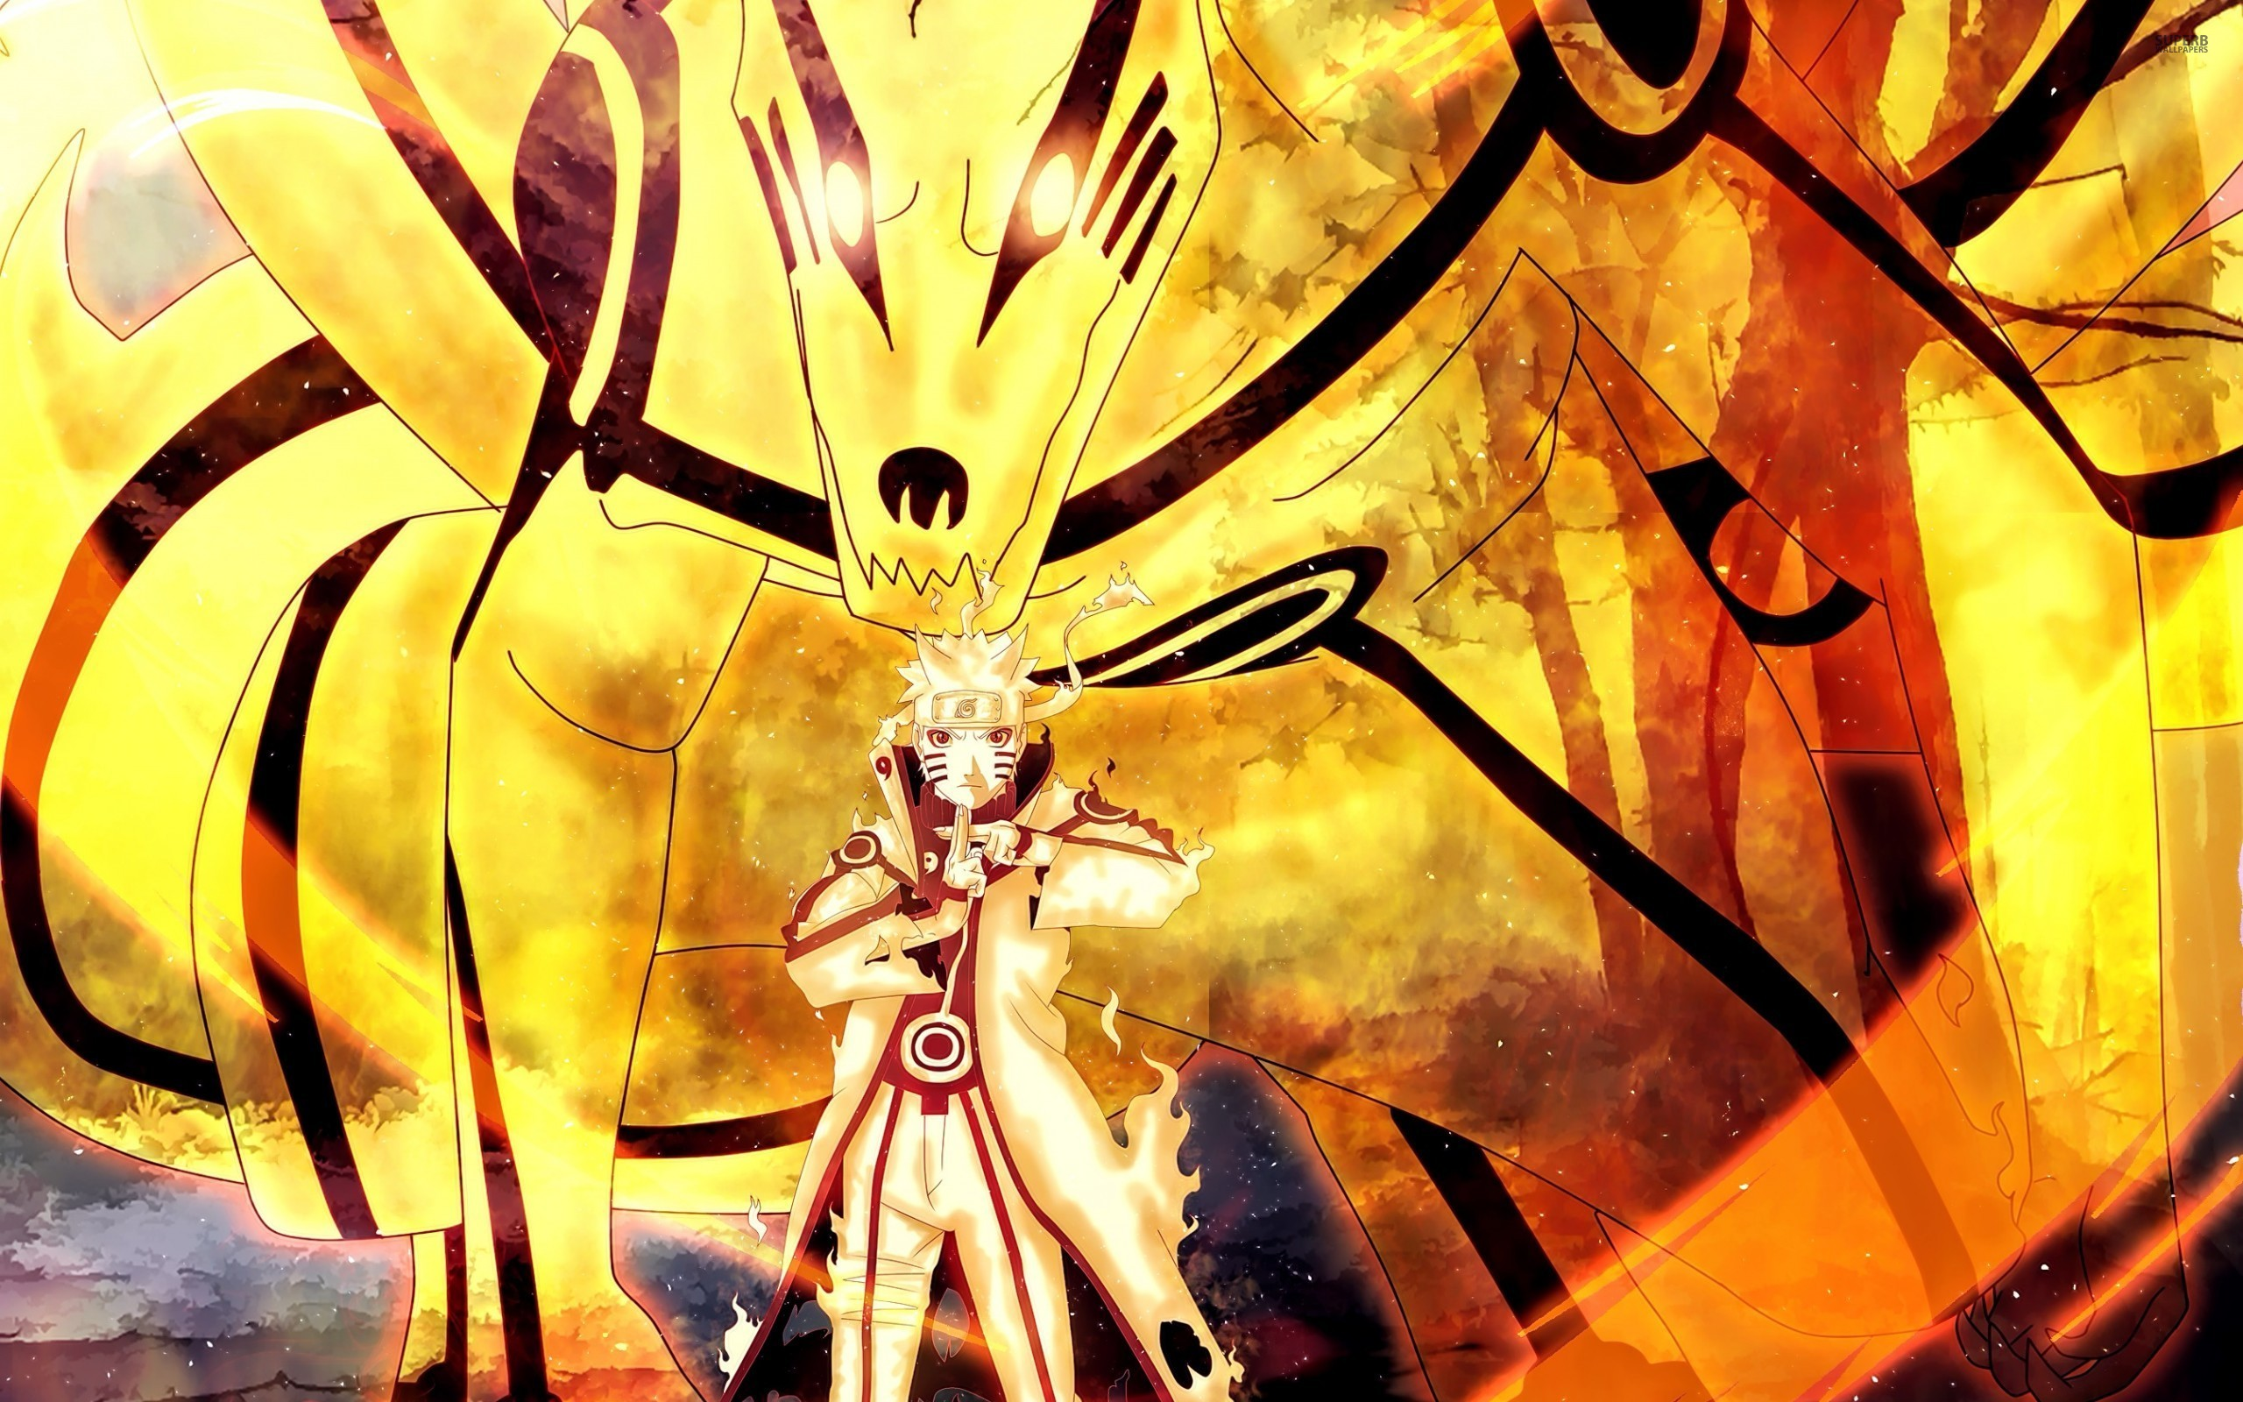
Features
Jumping , Sprinting , Double Jumping
Close Combat
Ranged attacks
Super attacks
Combos
Transformation
Final Battle
Notes:
Naimul

Slide 7
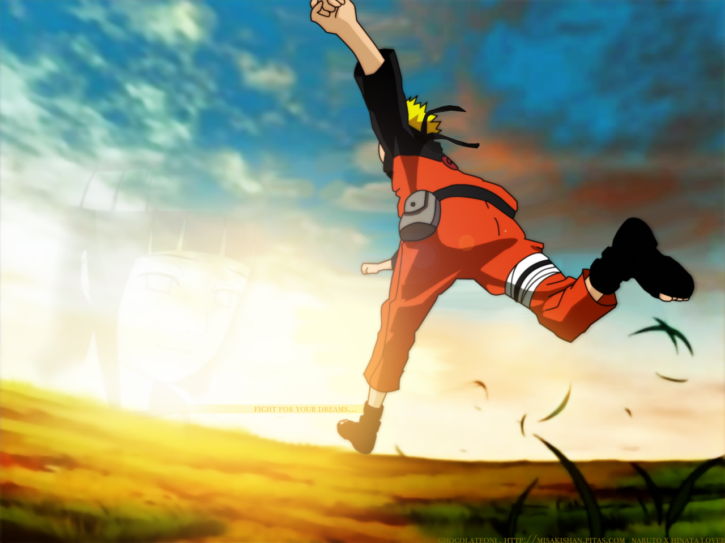
Jumping
Jumping over obstacles
Jumping over enemies
Double jumping
Notes:
Naimul

Slide 8
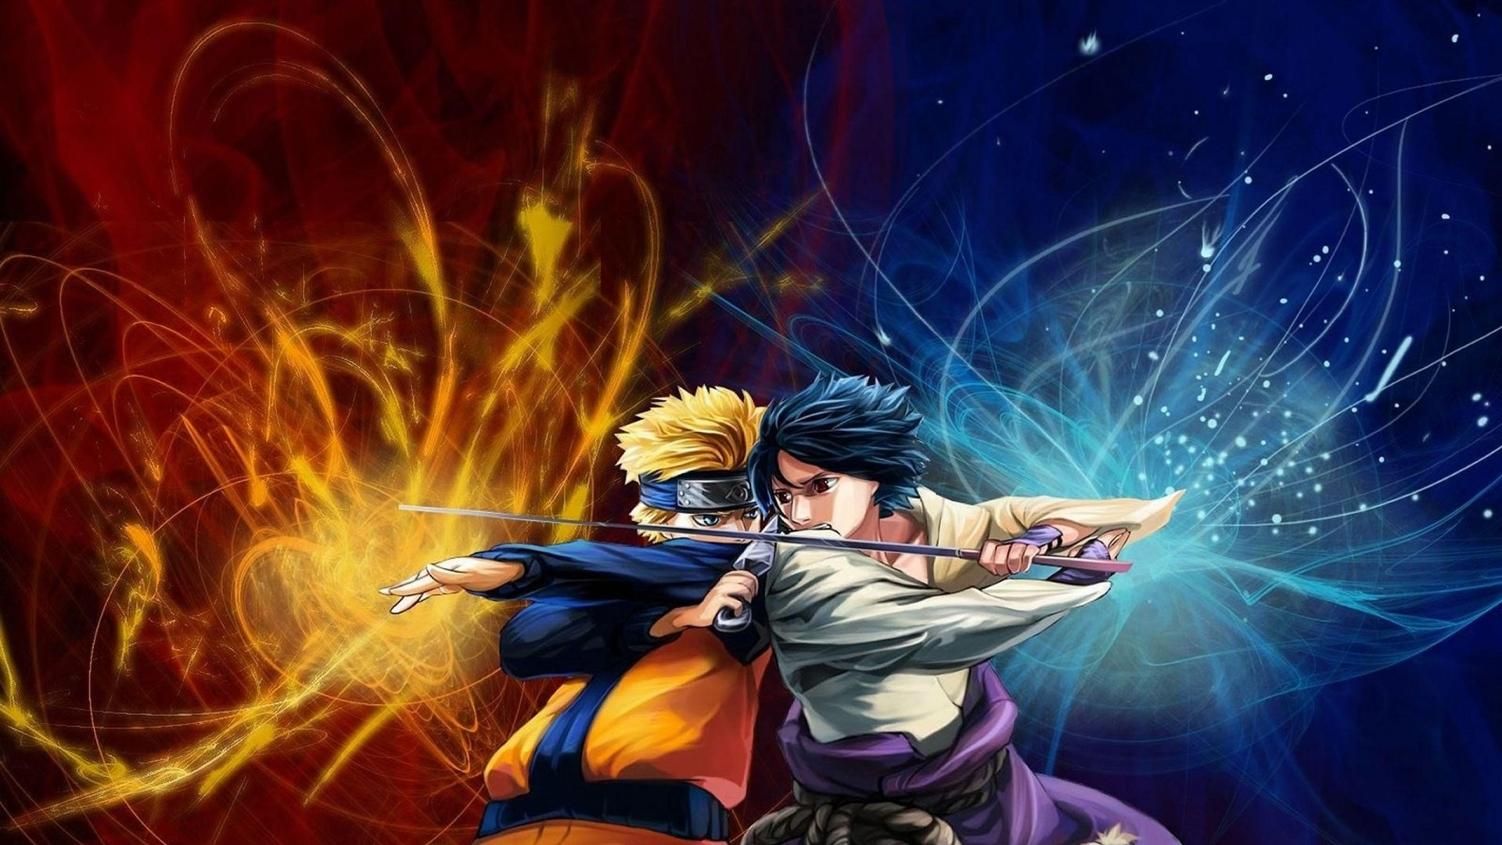
Combat
Hand to hand fights
Ranged attacks
Combo attacks
Ultimate attack
Transformation to nine tails form
Notes:
Naimul

Slide 9
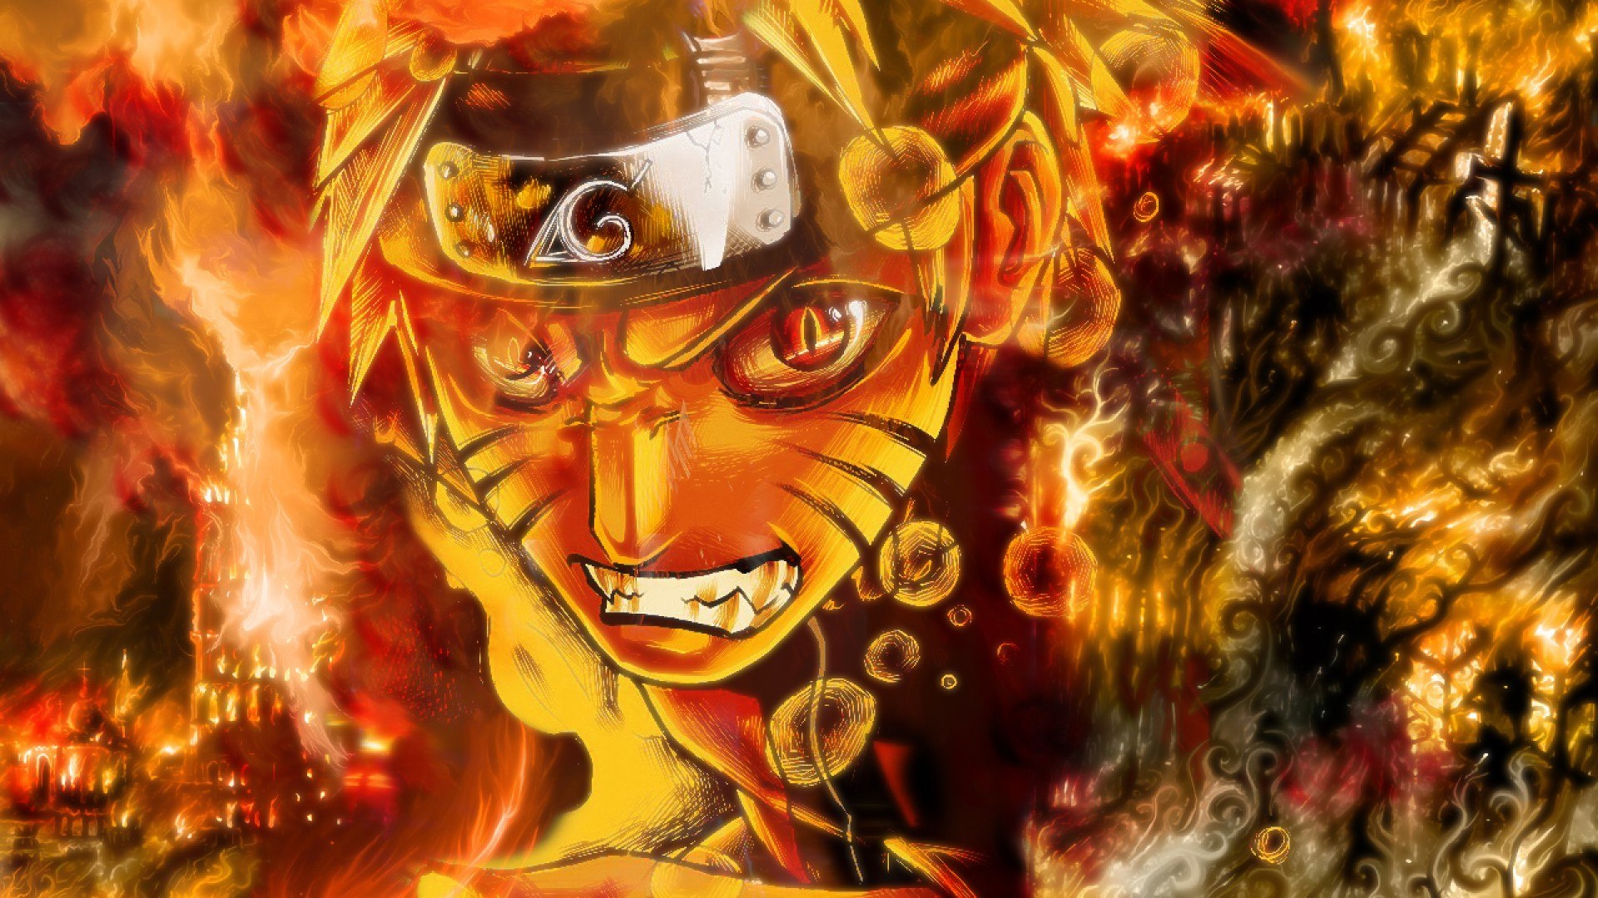
Finale
The final battle will be a battle between Naruto and Orochimaru , defeating the boss will end the game.
Notes:
Naimul

Slide 10
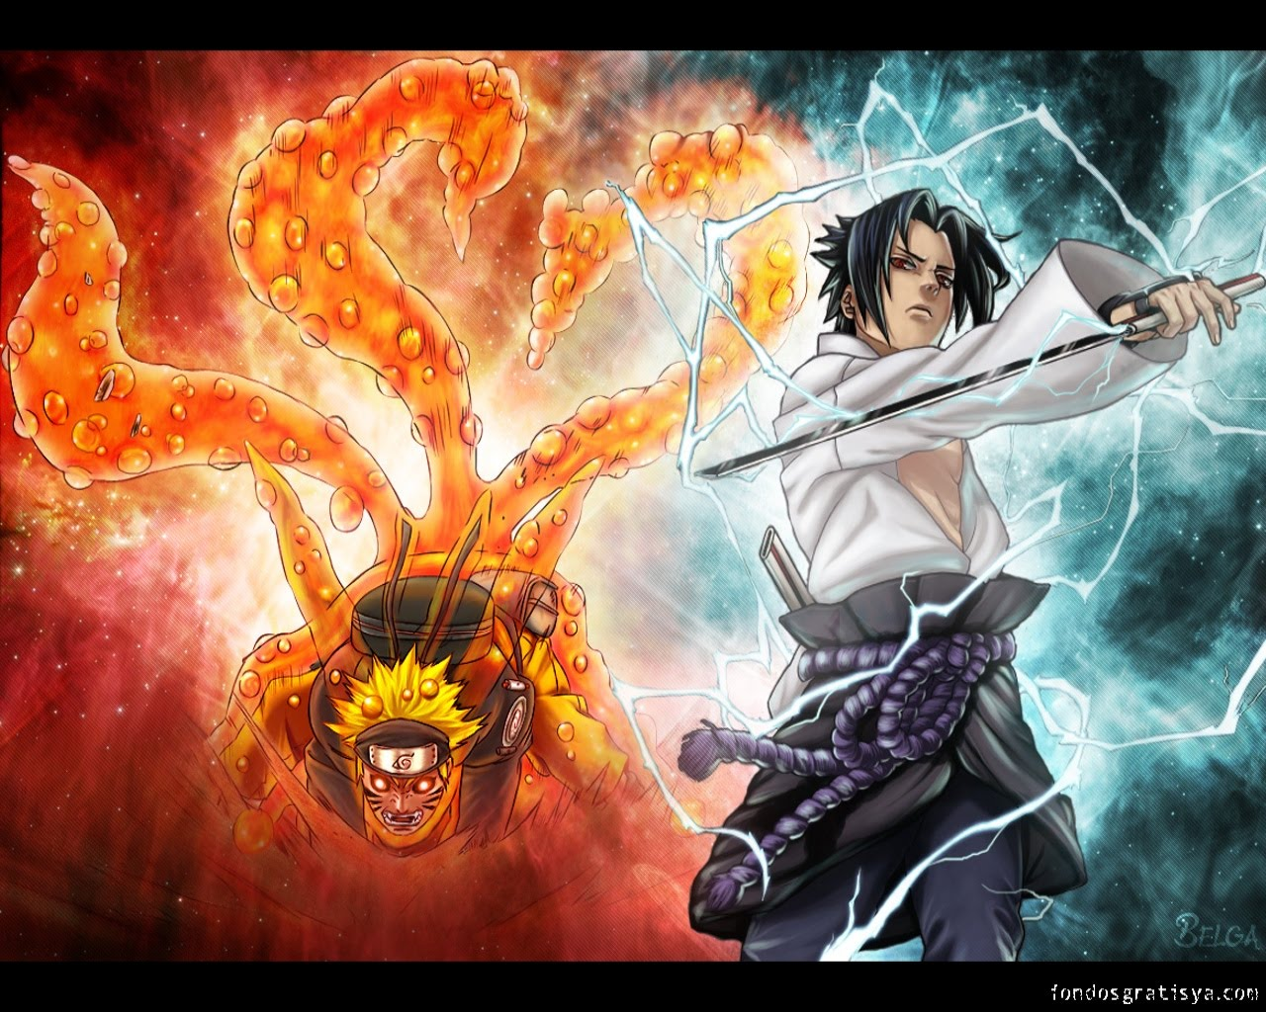
Additonal Features
Alongside all those features the game will have a highly animated user interface.
It will have a pause state and Save / Load option.
The game will have immersive sound effects and background music playback.
The game might contain a high score screen.
Notes:
Tokey

Slide 11
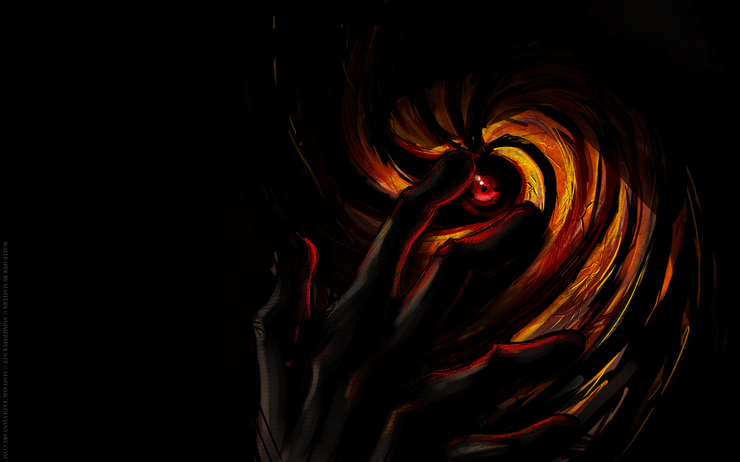
Software Requirements
IDE : Netbeans / Eclipse
Operating System : Ubuntu / Windows 7,8,10
Language : Java
Additional Software : Adobe Photoshop , Picasa , Photoscape , Adobe Lightroom , Paint etc.
Notes:
Tokey

Slide 12
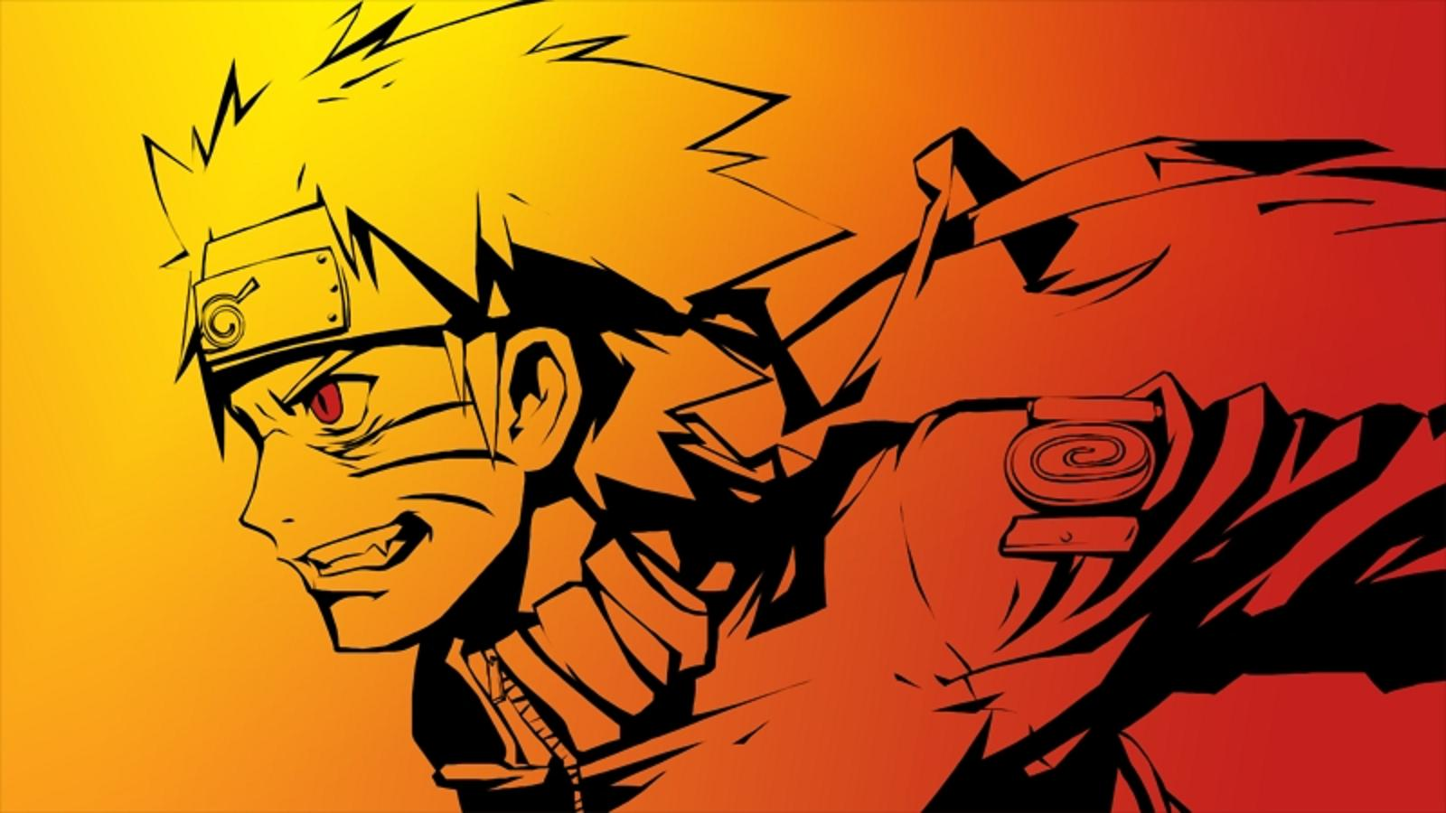
Conclusion
In short we are actually making an arcade game based on Naruto.
As we don’t know the limitations of java yet , the features may vary.
There will be a storyline which the game will be based upon.
Notes:
Tokey

Slide 13
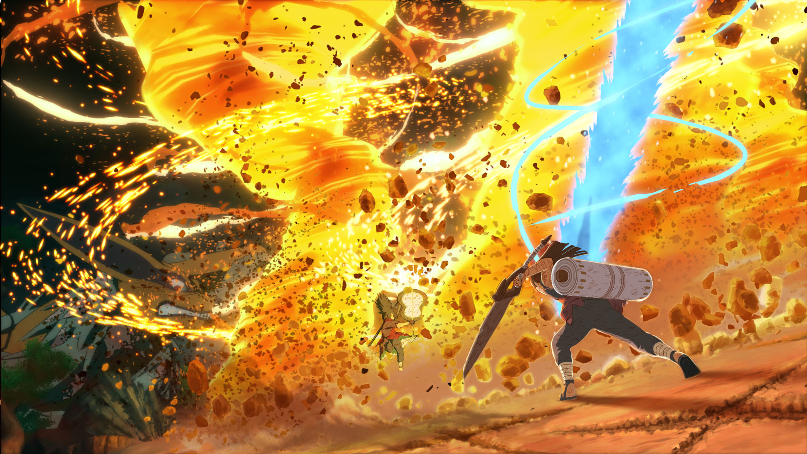

Any Questions?
Notes:
Tokey

Slide 14
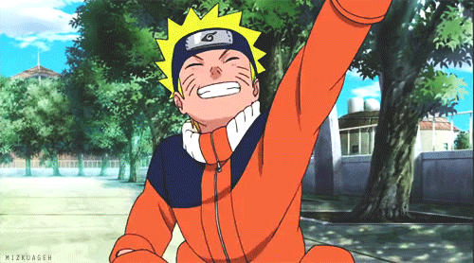
Thank You
Notes:
Tokey

